Slide 1
Why Do We Need Statistics?
Prof. Andy Field

Slide 2
Types of Data Analysis
Quantitative Methods
  Testing theories using numbers
Qualitative Methods
  Testing theories using language
    Magazine articles/Interviews
    Conversations
    Newspapers
    Media broadcasts

Slide 3
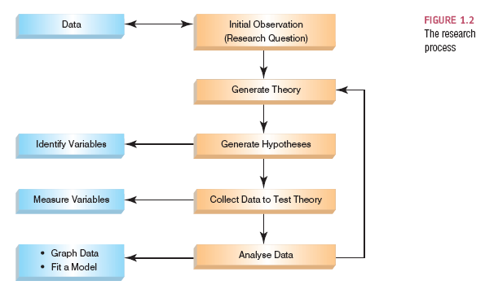
The Research Process

Slide 4
Initial Observation
Find something that needs explaining
  Observe the real world
  Read other research
Test the concept: collect data
  Collect data to see whether your hunch is correct
  To do this you need to define variables
    Anything that can be measured and can differ across entities or time.

Slide 5
The Research Process

Slide 6
Generating and Testing Theories
Theory
  A hypothesized general principle or set of principles that explains known findings about a topic and from which new hypotheses can be generated.
Hypothesis
  A prediction from a theory.
  E.g. the number of people turning up for a Big Brother audition that have narcissistic personality disorder will be higher than the general level (1%) in the population.
Falsification
  The act of disproving a theory or hypothesis.

Slide 7
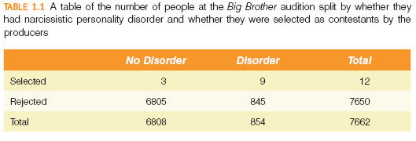

Slide 8
The Research Process

Slide 9
Data Collection 1: What to Measure?
Hypothesis:
  Coca-Cola kills sperm.
Independent Variable
  The proposed cause
  A predictor variable
  A manipulated variable (in experiments)
  Coca-Cola in the hypothesis above
Dependent Variable
  The proposed effect
  An outcome variable
  Measured not manipulated (in experiments)
  Sperm in the hypothesis above

Slide 10
Levels of Measurement
Categorical (entities are divided into distinct categories):
  Binary variable: There are only two categories
    e.g. dead or alive.
  Nominal variable: There are more than two categories
    e.g. whether someone is an omnivore, vegetarian, vegan, or fruitarian.
  Ordinal variable: The same as a nominal variable but the categories have a logical order
    e.g. whether people got a fail, a pass, a merit or a distinction in their exam.
Continuous (entities get a distinct score):
  Interval variable: Equal intervals on the variable represent equal differences in the property being measured
    e.g. the difference between 6 and 8 is equivalent to the difference between 13 and 15.
  Ratio variable: The same as an interval variable, but the ratios of scores on the scale must also make sense
    e.g. a score of 16 on an anxiety scale means that the person is, in reality, twice as anxious as someone scoring 8.

Slide 11
Measurement Error
Measurement error
  The discrepancy between the actual value we’re trying to measure, and the number we use to represent that value.
Example:
  You (in reality) weigh 80 kg.
  You stand on your bathroom scales and they say 83 kg.
  The measurement error is 3 kg.

Slide 12
Validity
Whether an instrument measures what it set out to measure.
Content validity
  Evidence that the content of a test corresponds to the content of the construct it was designed to cover
Ecological validity
  Evidence that the results of a study, experiment or test can be applied, and allow inferences, to real-world conditions.

Slide 13
Reliability
Reliability
  The ability of the measure to produce the same results under the same conditions.
Test–Retest Reliability
  The ability of a measure to produce consistent results when the same entities are tested at two different points in time.

Slide 14
Data Collection 2: How to Measure
Correlational research:
  Observing what naturally goes on in the world without directly interfering with it.
Cross-sectional research:
  This term implies that data come from people at different age points, with different people representing each age point.
Experimental research:
  One or more variable is systematically manipulated to see their effect (alone or in combination) on an outcome variable.
  Statements can be made about cause and effect.

Slide 15
Experimental Research Methods
Cause and Effect (Hume, 1748)
  Cause and effect must occur close together in time (contiguity).
  The cause must occur before an effect does.
  The effect should never occur without the presence of the cause.
Confounding variables: the ‘Tertium Quid’
  A variable (that we may or may not have measured) other than the predictor variables that potentially affects an outcome variable.
  E.g. the relationship between breast implants and suicide is confounded by self-esteem.
Ruling out confounds (Mill, 1865)
  An effect should be present when the cause is present and that when the cause is absent the effect should be absent also.
  Control conditions: the cause is absent.

Slide 16
Methods of Data Collection
Between-group/between-subject/independent
  Different entities in experimental conditions
Repeated-measures (within-subject)
  The same entities take part in all experimental conditions.
  Economical
  Practice effects
  Fatigue

Slide 17
Types of Variation
Systematic Variation
  Differences in performance created by a specific experimental manipulation.
Unsystematic Variation
  Differences in performance created by unknown factors.
    Age, gender, IQ, time of day, measurement error, etc.
Randomization
  Minimizes unsystematic variation.

Slide 18
The Research Process

Slide 19
Analysing Data: Histograms
Frequency Distributions (aka Histograms)
  A graph plotting values of observations on the horizontal axis, with a bar showing how many times each value occurred in the data set.
The ‘Normal’ Distribution
  Bell-shaped
  Symmetrical around the centre

Slide 20
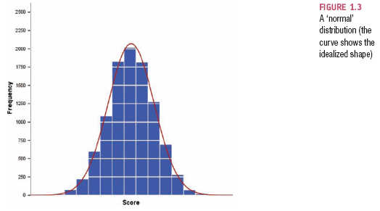
The Normal Distribution

Slide 21
Properties of Frequency Distributions
Skew
  The symmetry of the distribution.
  Positive skew (scores bunched at low values with the tail pointing to high values).
  Negative skew (scores bunched at high values with the tail pointing to low values).
Kurtosis
  The ‘heaviness’ of the tails.
  Leptokurtic = heavy tails.
  Platykurtic = light tails.

Slide 22
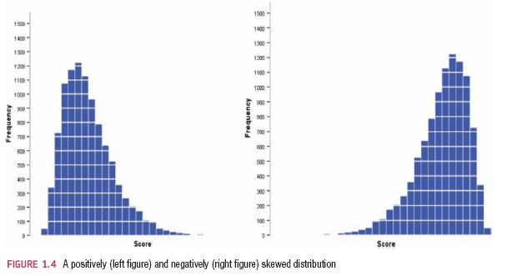
Skew

Slide 23
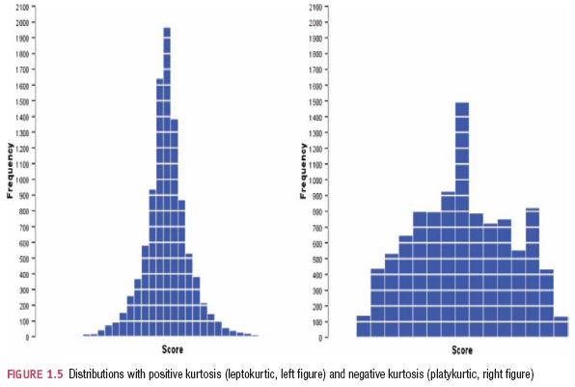
Kurtosis

Slide 24
Central tendency: The Mode
Mode
  The most frequent score
Bimodal
  Having two modes
Multimodal
  Having several modes

Slide 25
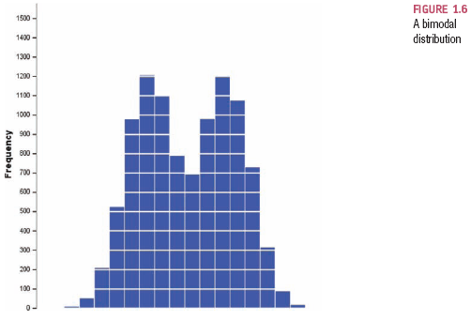
A Bimodal Distribution

Slide 26

Central Tendency: The Median
Median
  The middle score when scores are ordered.
Example
  Number of friends of 11 Facebook users.

Slide 27
Central Tendency: The Mean
Mean
  The sum of scores divided by the number of scores.
  Number of friends of 11 Facebook users.

Slide 28
The Dispersion: Range
The Range
  The smallest score subtracted from the largest
Example
  Number of friends of 11 Facebook users.
  22, 40, 53, 57, 93, 98, 103, 108, 116, 121, 252
  Range = 252 – 22 = 230
  Very biased by outliers

Slide 29
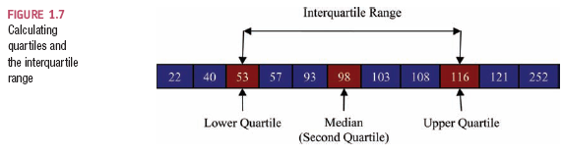
The Dispersion: The Interquartile range
Quartiles
  The three values that split the sorted data into four equal parts.
  Second quartile = median.
  Lower quartile = median of lower half of the data.
  Upper quartile = median of upper half of the data.

Slide 30
Going beyond the data: z-scores
z-scores
  Standardising a score with respect to the other scores in the group.
  Expresses a score in terms of how many standard deviations it is away from the mean.
  The distribution of z-scores has a mean of 0 and SD = 1.

Slide 31
Properties of z-scores
1.96 cuts off the top 2.5% of the distribution.
−1.96 cuts off the bottom 2.5% of the distribution.
As such, 95% of z-scores lie between −1.96 and 1.96.
99% of z-scores lie between −2.58 and 2.58.
99.9% of them lie between −3.29 and 3.29.

Slide 32
Types of Hypotheses
Null hypothesis, H0
  There is no effect.
  E.g. Big Brother contestants and members of the public will not differ in their scores on personality disorder questionnaires
The alternative hypothesis, H1
  Aka the experimental hypothesis
  E.g. Big Brother contestants will score higher on personality disorder questionnaires than members of the public

